Slide 2


Oracle Application Express 4.1 New Features
Mike Hichwa, Vice President, Database Tools

Slide 3
The following is intended to outline Oracle’s general product direction. It is intended for information purposes only, and may not be incorporated into any contract. It is not a commitment to deliver any material, code, or functionality, and should not be relied upon in making purchasing decisions.
The development, release, and timing of any features or functionality described for Oracle’s products remains at the sole discretion of Oracle.

Slide 4

Program Agenda
Oracle Application Express Overview
New Features in 4.1
Beyond Oracle APEX 4.1…
Q&A

Slide 5
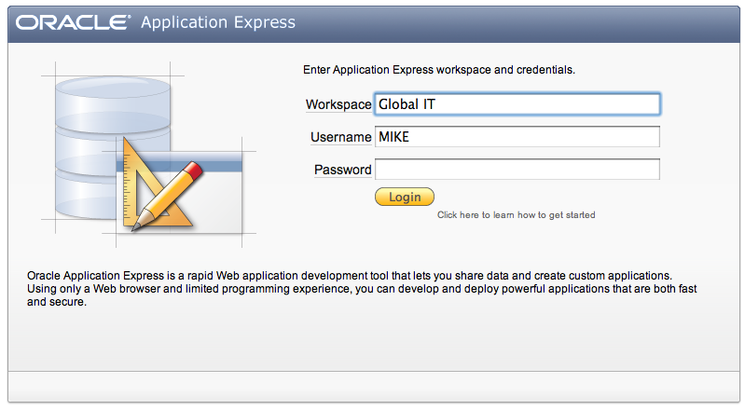
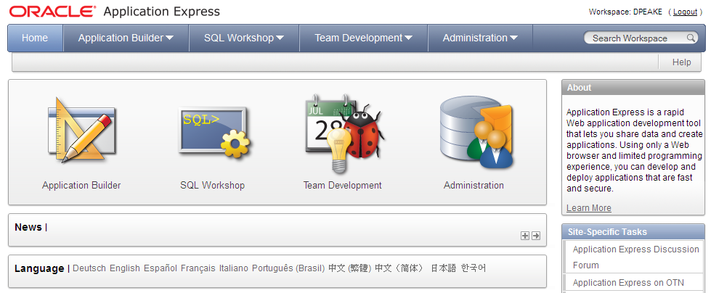
Oracle Application Express (Oracle APEX)
Browser Based Application Development

Slide 6

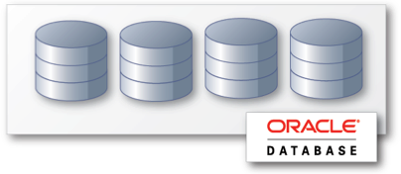
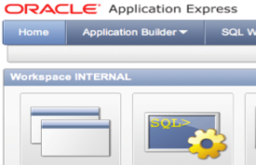

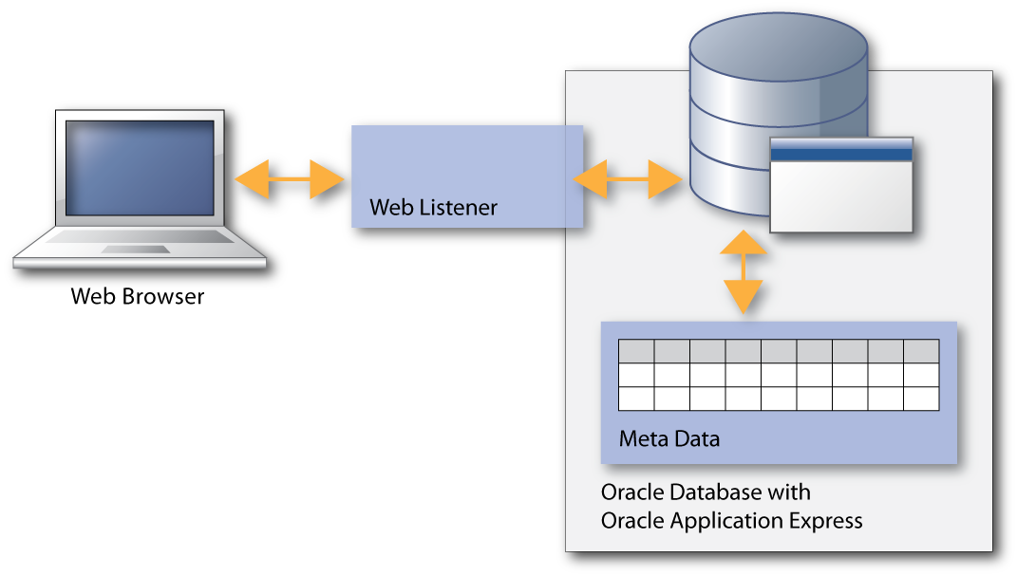
Oracle Application Express (Oracle APEX)
Benefits
Rapid Browser Based Development
Leverage SQL Skills
Point your browser and start developing
Build reports and charts using SQL
Self Service Provisioning
Runs within Database
Out-of-the-box elastic private cloud service
Simple to manage, highly scalable

Slide 7
Oracle Application Express (Oracle APEX)
Architectural Overview
Simple 2-Tier Architecture
Pages dynamically rendered using database Meta data
No code generation or file based compilation
Runs everywhere Oracle Database runs

Slide 8

Oracle Application Express (Oracle APEX)
Fully supported no-cost feature of Oracle DB
Distributed with
  Oracle Enterprise Edition
  Oracle Standard Edition
  Oracle Standard Edition One
  Oracle XE
Supported Database Releases
  10gR2
  11gR1
  11gR2

Slide 9
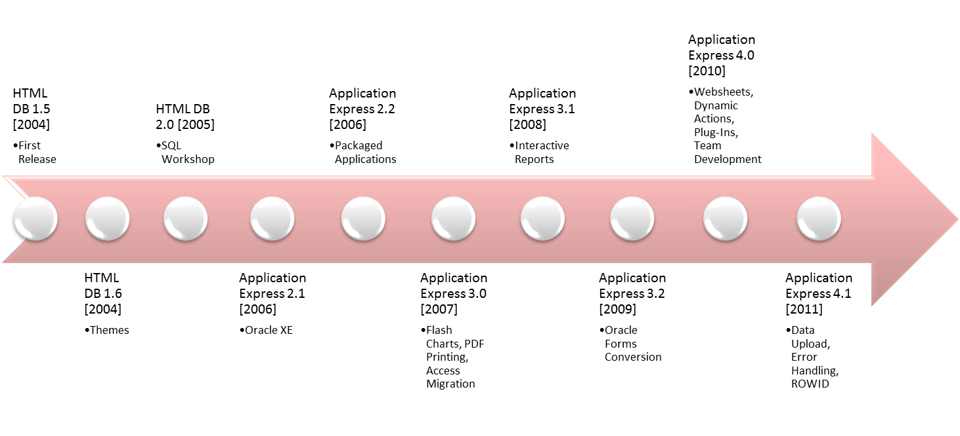
Oracle Application Express (Oracle APEX)
History

Slide 10
Program Agenda
Oracle Application Express Overview
New Features in 4.1
Beyond Oracle APEX 4.1…
Q&A

Slide 11

Error Handling
    Error Handling Function
    Provide developers full control when an error occurs
    Capabilities include:
        Log all errors
        Map errors raised by the Oracle Database (like “Unique constraint XYZ violated”) to friendlier error messages
        Display all errors “Inline in Notification”
        Increase security by masking internal APEX errors

Slide 12

Use of ROWID
    Allow usage of ROWID for Automatic DML Processing
    Tables with > 2 Primary Key(PK) columns supported
    Support for PK columns that are also a Foreign Key
    Alternative to identification of Primary Key columns
    Ability to create Form, Form & Report or Tabular Form on
    Table or View with no Primary Key

Slide 13

Data Upload
  Provide the ability for end-users to update spreadsheet data into tables
    Developer uses wizard to specify parameters
    Following pages created:
      Data Load Source
      Data / Table Mapping
      Data Validation
      Data Load Results

Slide 14

Calendar
  Added “Drag and Drop” functionality
    Change Date and Time of records
  Added ability to create “Edit” page as part of calendar wizard
    “Edit” Page types of:
      Existing page
      Pop-up page
      New page

Slide 15
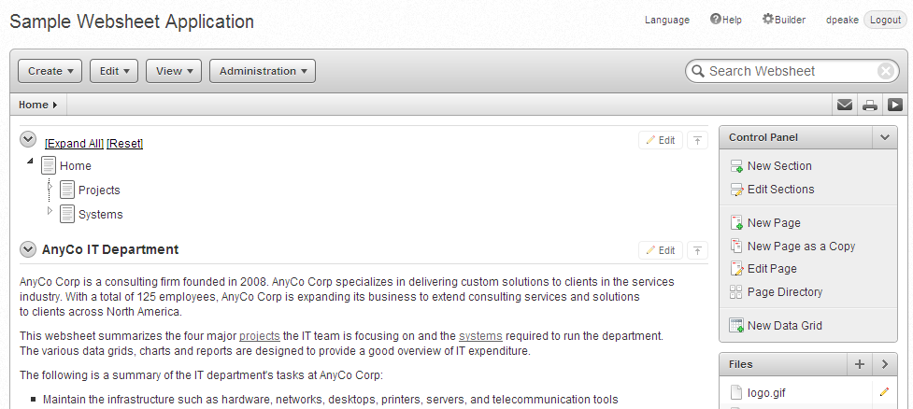
Websheet Enhancements
  Improved User Interface – offers greater control
  New Page Section Type – PL/SQL
  Query using Datagrid
  Presentation mode

Slide 16


Tabular Form Validations and Processes
  Support all the same validation types as a Page Item
  (e.g. PL/SQL Expression, Exists, etc)
  Allow referencing of column values in Validations and Processes
  using Bind Variable syntax:
    :COLUMN_NAME
    Built-in Bind variables -
    APEX$ROW_SELECTOR, APEX$ROW_NUM and APEX$ROW_STATUS
  Validations & Processes can be fired for each submitted row
  or once for the entire submission
  Advisor has been enhanced to check for valid Tabular Form columns

Slide 17

Plug-In Enhancements
  Increased Number of Custom Attributes to 15
  New Attribute Type - ‘Checkboxes’
  Add plug-in Support for
    Authentication Schemes
    Authorization Schemes
  Attribute Usability Enhancements in Application Builder

Slide 18

Dynamic Action Enahncements
Declarative support for buttons to trigger dynamic actions
  Actions performed based on button clicks
  Works for HTML, Image and Template based buttons
Extend the Submit Page dynamic action to gray out the page
and show a processing icon
Improve the ability to define multiple item values within ‘Set Value’

Slide 19
Accessibility
  Improved Menu accessibility
  Added ability to define row headers for tabular form fields
  Added “High Contrast” mode
  Improved usability for screen reader users when dealing with validation errors
  Integrated updated version of Rich Text Editor, offering improved accessibility

Slide 20
Application Translations
  Modernized the Translation user interface
  Streamlined the translation process
  Minimize the translation requirements for repeated values

Slide 21
Dynamic List
  Base list on SQL or PL/SQL functions
    Dynamically create styled list items
  Especially important for mobile based applications

Slide 22

Mobile Applications
  Provide themes & HTML templates suitable for
  smart phones and mobile devices
    jQuery Mobile*
    Dynamic List Support
    Improved HTML out of the box
    * We plan to bundle jQuery Mobile into a future release of Application Express

Slide 23
Other New Features in 4.1
Many Functional & Performance Improvements
New AnyChart Flash Charts
New CKEditor version
New jQuery and jQuery UI versions

Slide 24
Program Agenda
Oracle Application Express Overview
New Features in 4.1
Beyond Oracle APEX 4.1…
Q&A

Slide 25

Beyond Oracle APEX 4.1…
Proposed Future Release Features
  Enhanced themes and HTML templates to enable developers to declaratively create mobile applications and/or mobile pages.
  Incorporate HTML 5 charting capabilities.
  Declarative specification of RESTful Web services mapped to SQL and PL/SQL.
  Modal Dialogues
  Multiple Tabular Forms on one page
    Master-Detail-Detail support
  Multiple Interactive Reports on one page

Slide 26
Program Agenda
Oracle Application Express Overview
New Features in 4.1
Beyond Oracle APEX 4.1…
Q&A

Slide 27


Slide 28



